Slide 1
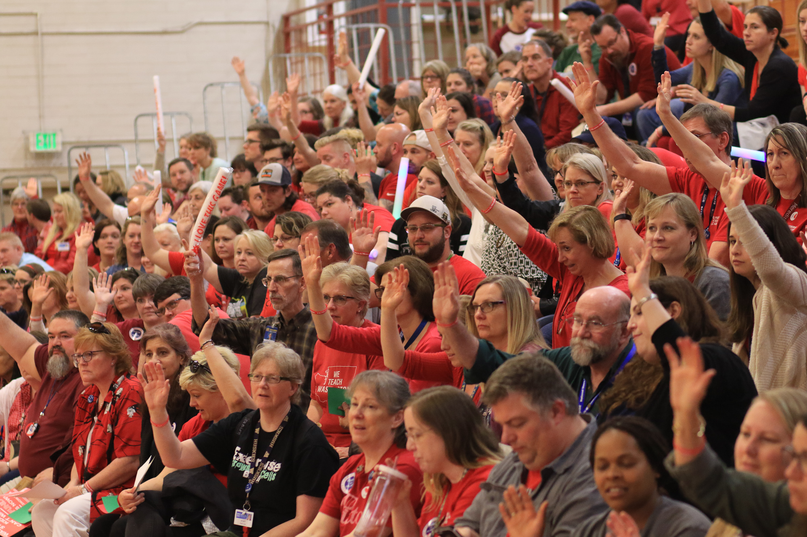
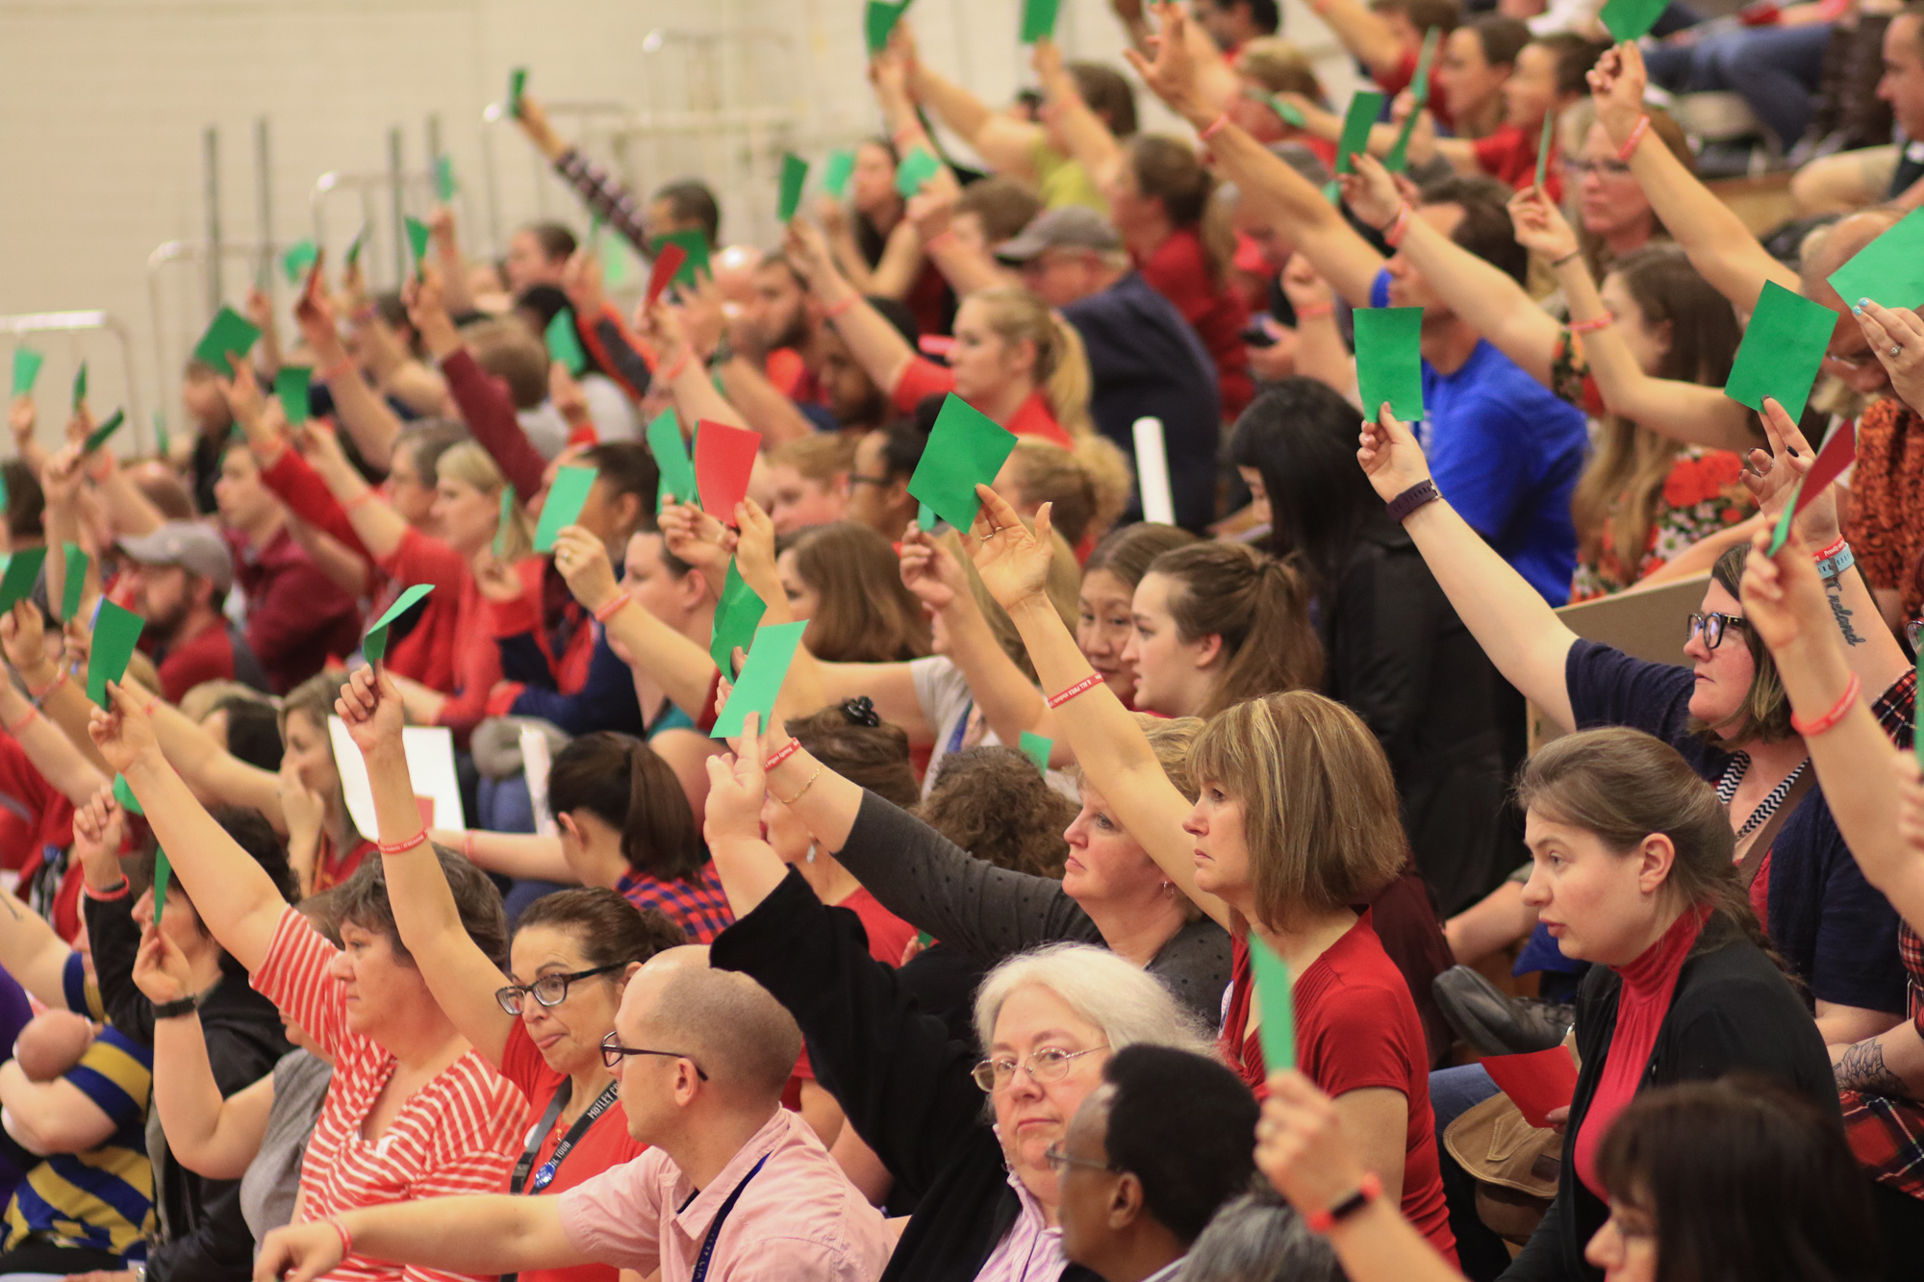
May 10 Minute FWEA Meeting
FWEA Members Only!
We appreciate all who came to our powerful
General Membership Meeting!

Slide 2
Like and share our public Federal Way Education Association Facebook page! Help us grow our social media presence! (30 seconds)

Slide 3
FWEA Association Representative Elections (1 min)
Have a voice in our profession!
Important leadership in decision making
Critical role in new collective bargained agreement
As per our Constitution and Bylaws, there is 1 representative per 10 members or major portion (ex: 25 members means 3 representatives)
Election will occur by private, paper ballot on or before Friday, June 2 and shared to tiafwea@aol.com

Slide 4
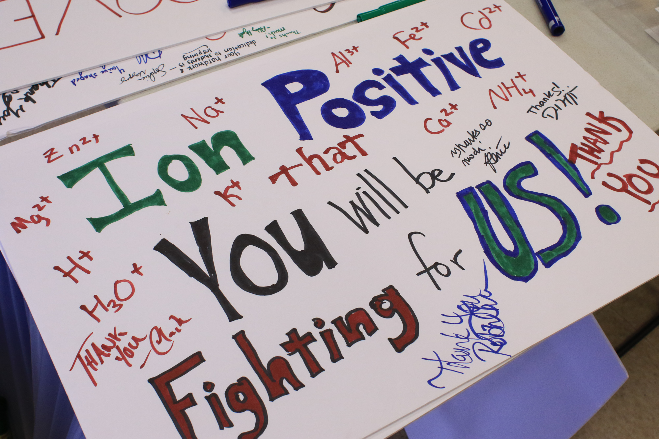
We are all Bargaining Support (2 mins)
- Nobody has our backs better than ourselves. Each of us is authentically needed in our efforts!
May is the last bargaining Blast Meeting until August by your Bargaining Support Team
You will receive updates, requests for narrative, potential surveys and the invite to August General Membership via home email (NOT fwps email)
Are your BAT teams prepared for summer? (texting or email?)
Voting will occur in person in August (NOT online).
Legislative and local bargaining will impact what motions
we will vote on

Slide 5
Bell schedules, Contract policy, 4+1 (2 mins)
Contracts will come in the beginning of June. You will have 10 days to sign and return. This is your responsibility. If you sign it, you have until July 31 to ask to be released from your contract.
Bell schedule: FWEA members shared their questions and concerns through a question survey posted on Facebook. This was shared to the district in Labor Management. Late start elementaries and Sacajawea are the most impacted.
The employer has the authority to set start and end times (not bargainable).
FWEA did not support the use of our name in a memo about these changes, and a new norm in Labor-Management was developed to avoid this in the future.
4+1 Days: In Labor-Management, we are also working to ensure the 4+1 calendar is much better this year.

Slide 6
ARs are thinking ahead (1 min)
We’re looking at the shared decisions to consider what needs to be improved in our site next year
We meet with the principal monthly, and hope to troubleshoot before we come to the whole group
Input is welcome (PLCs, sub rotation, rainy day recess, picking dates for PD once we have the district calendar etc.). Full list at federalwayea.org under ‘collective bargaining agreements’

Slide 7
(2 mins)
Sign wave, get a free drink ticket, then ‘drink red for ed’ and have some fun together!

Slide 8
Remember $220 FWEA Reimbursement (1 min)
http://www.federalwayea.org/uploads/4/3/0/2/43023511/form0120-220.pdf
Reimbursement must be received by PAYROLL by June 30th
For ALL certificated members
Receipts or payroll compensation
This was negotiated, so make sure to use this!

Slide 9
Upcoming FWEA Events (information and sign-up at federalwayea.org)
May 22 Special Education Meet-Up
May 23 Music Meet-Up
May 25th FWEA Appreciation and Drink Red for Public Ed
June 4th FWEA Member Retirement Appreciation
June 8th Student Loan Forgiveness Seminar
(LGBTQ and Allied meet-up and Educators of Color meet-up tba)

Slide 10
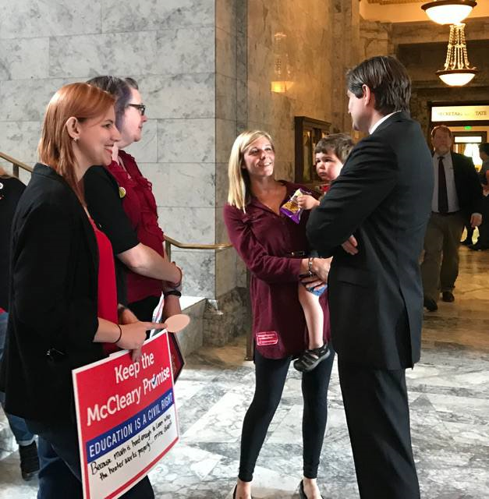
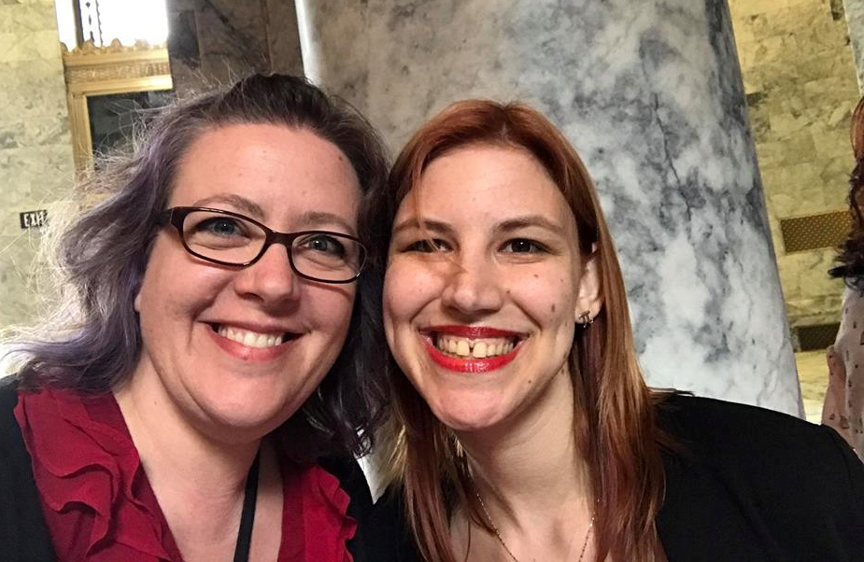
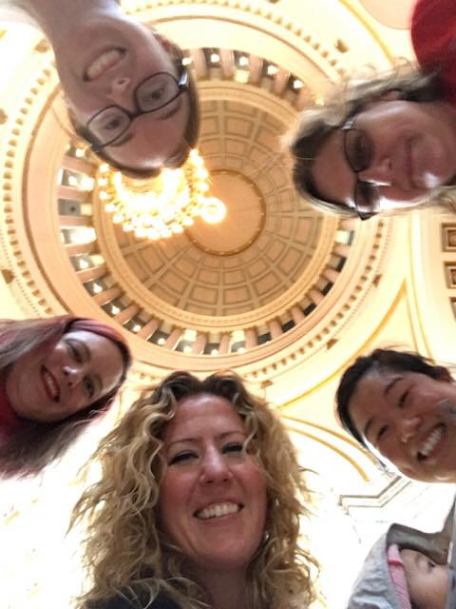
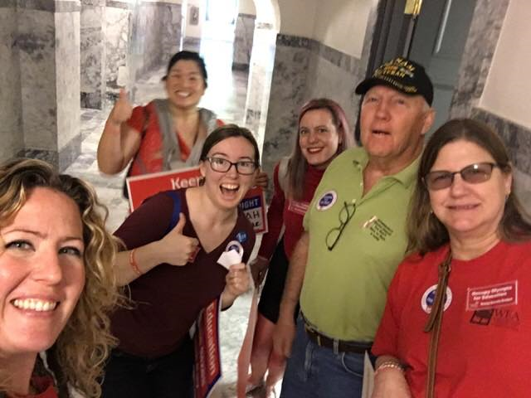
Come Occupy Olympia http://bit.ly/OccupyOly Friday 5/19 and Tues 5/23 (FWEA pays for your sub- its not Wellness)

